Slide 1


JRuby & TorqueBox Web, and Workers, and Clusters, Oh My

Slide 2
Who am I?
Chris Meadows
Principle Software Engineer & Architect
Signal Mountain Software, LLC
Email: chris@signalmountainsoftware.com
Twitter: @meadoch1
1996-2013 Professional application development with most all the buzzwords
February 2012 – today: Ruby development

Slide 3
Credit where Due!
Joe Kutner – Deploying with JRuby, @codefinger

Slide 4
Agenda
Why JRuby?
Using JRuby
Moving to JRuby
Why TorqueBox?
What’s in it?
Moving to TorqueBox
Q&A

Slide 5
What is JRuby?
“The Ruby Programming Language on the JVM”
- From jruby.org

Slide 6
So what?
Real Threads
A Seasoned JVM
Rich Ecosystem
“Corporate Approval”
and more

Slide 7
Background
Started in 2001 (Ruby 1.6)
2004 the current core team began
July 2009 core team moved from Sun to Engine Yard
May 2012 some went to Red Hat
Main devs:
Thomas Enebo
Charles Nutter
Nick Sieger
Active development sponsored by Red Hat and Engine Yard

Slide 8
Focus
Developer Productivity
Easy Development of Complex Web Apps
Notes:
Developer Productivity
Pervasive Conventions
Less code required
Elimination of boilerplate*
Easy Development of Complex Web Apps
Long lived states
Very different flow than request/response

Slide 9
Where’s the Magic?
Dynamic Runtime Code Generation
Proxies
Observers

Slide 10
Where will I get stuck?
Learn (& follow) the Conventions!
Data exchange
Not a traditional web site mentality
“If something is very difficult, you’re probably
doing it wrong” - Peepcode

Slide 11
And now for something completely different…

Slide 12
Example Application
Last One Standing
Standup “who goes next” randomizer
Participants
have names and a state
States
there are 3: waiting, hotseat, and gone

Slide 13
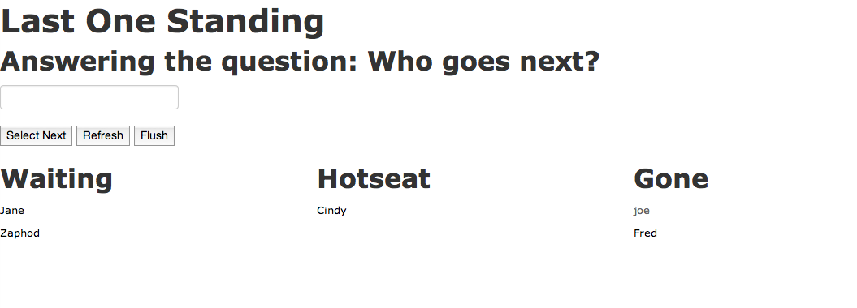
Example Application Screenshot

Slide 14
Now back to your regularly scheduled program

Slide 15
After one more sidenote…

Slide 16
MVC
(R)
No “pure” MVC
R = Router

Slide 17
How do I make it work?

Slide 18
Application Components
Model(s)
Controller
View
Template
Router

Slide 19
Application Components Information Flow
Data
Model
Controller
View
Template
Events
Router updates models &
controllers based on events
Router

Slide 20
Application Components Information Lifecycles
Component | Data Lifecycle
Models | The life of the application
Controllers | The life of the session
Views | The life of the page view
Templates | The life of the page view
Router | State machine for session

Slide 21
Application Components Models
Model(s)
Controller
View
Template
Hold, retrieve, and store data
Lifetime of application
Ignorant of Controllers, Views, app state
Can depend on other models
Router

Slide 22
Application Components Models
Model(s)
Controller
View
Template
Data frequently retrieved through API utilizing an Adapter
Models should go through an Identity Map
Router

Slide 23
Application Components Models
Model(s)
Controller
View
Template
To work with the router a model must implement:
find(id) – look up and initialize a model based on an id
then(success, failure) – promise pattern
Extend Ember.Object (unless using ember-data)
Router

Slide 24
Application Components Models – Ember-data
An ORM built for Ember
Implements Store (including an Identity Map), Adapters, and Serializer
RESTAdapter & BasicAdapter
Supports associations between models
Implements the Router required methods
In “beta” phase, but usable

Slide 25

Application Components Models
Model(s)
Controller
View
Template
Router

Slide 26
Application Components Controllers
Model(s)
Controller
View
Template
Make model data accessible to view
Handle events
Store “transitory” data
Life of session
Lazily instantiated once upon need
Router

Slide 27
Application Components Controllers
Model(s)
Controller
View
Template
Included Controllers:
Ember.Controller
Ember.ObjectController *
Ember.ArrayController *
* Allows proxying of underlying model
Router

Slide 28
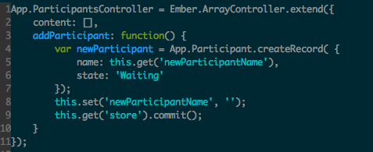
Application Components Controllers

Slide 29
Application Components Views
Model(s)
Controller
View
Template
DOM Interaction
Browser events -> semantic events
Frequently optional
Lifetime of page view
Should bind to only one controller
Router

Slide 30
Application Components Views
Model(s)
Controller
View
Template
Events Surfaced
Common DOM events (keyDown, mouseMove, touchStart…)
“Workflow” events – didInsertElement, willDestroyElement, etc
Full list at http://emberjs.com/api/classes/Ember.View.html
Router

Slide 31
Application Components Templates
Model(s)
Controller
View
Template
HTML Output
Utilize data bindings
Lifetime of page view
Uses Handlebars
Router

Slide 32
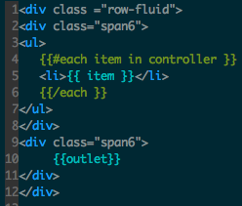
Application Components Templates
Model(s)
Controller
View
Template
Router

Slide 33

Application Components Templates
Conditionals

Slide 34
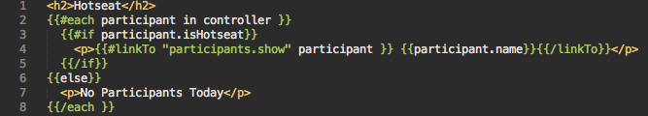
Application Components Templates
Loops & Link to

Slide 35
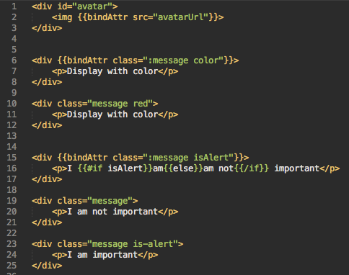
Application Components Templates
Bound Expressions

Slide 36
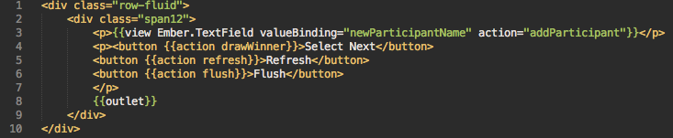
Application Components Templates
Actions & Outlets

Slide 37
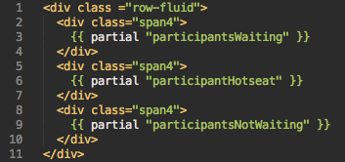
Application Components Templates
Partials

Slide 38
Application Components Router
Model(s)
Controller
View
Template
Router
Map URL to state & objects
Handles data loading for controllers

Slide 39

Application Components Router
Load model data into
controller model/content

Slide 40

Application Components Router
Redirection

Slide 41
Application Flow
Data
Model
Controller
View
Template
Events
Router updates models &
controllers based on events
Router

Slide 42
Application Components Information Lifecycles
Component | Data Lifecycle
Models | The life of the application
Controllers | The life of the session
Views | The life of the page view
Templates | The life of the page view
Router | State machine for session

Slide 43
Application Structure
Few Files
All JS in one file
All templates and html in a second file
Broken up
Each class in it’s own file
Each template in a .handlebars file
Separate directories to store components (ie views, models, etc)
Pros
simple
no “build” required
Cons
bad organization for non-trivial projects
Pros
modular file organization
Cons
lots of files to handle
need a “build” process (largely automated by tools though)
Notes:
Flexible – pipelining, binary safe strings
Rearrange in tables

Slide 44
Application Bootstrap
Need to define the following:
“App”
App.Router
App.Store
Must include all files manually

Slide 45
Application Bootstrap Define “App”
Provide namespacing for objects
Needs to be instantiated before the other js files are loaded

Slide 46
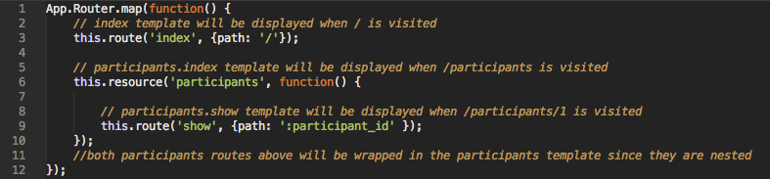
Application Bootstrap Define Router
Similar to Rails routes.rb
Maps URLs to objects through the naming conventions

Slide 47
Application Bootstrap Naming Conventions
URL | Route Name | Controller | Route | Template
/ | index | IndexController | IndexRoute | index
NA | participants | ParticipantsController | ParticipantsRoute | participants
/participants | participants.index | ParticipantsIndexController | ParticipantsIndexRoute | participants/index
/participants/6 | participants.show | ParticipantsShowController | ParticipantsShowRoute | participants/show

Slide 48

Application Bootstrap Define Store
Defines how data will be retrieved
Mainly used with ember-data

Slide 49
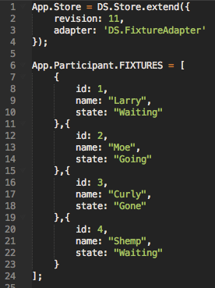
Application Bootstrap Define Store
Sidenote
If using ember-data, set adapter to “DS.FixtureAdapter” to get easy test data loading

Slide 50
Show the application!

Slide 51
Questions?

Slide 52
More info
Dig into emberjs.com for more depth
Google “ember.js”
I’d be glad to talk
Chris Meadows
meadoch1@gmail.com
@meadoch1 (Twitter)
https://github.com/meadoch1/lms

